Slide 1

Medi-Screen
Eoghan murray
Zac dair
Aoise warner
Daniel murphy

Slide 2
Contents
Medi-Screen Web Portal
- Doctor
- Insurance

Slide 3
Medical Web Portal

Slide 4
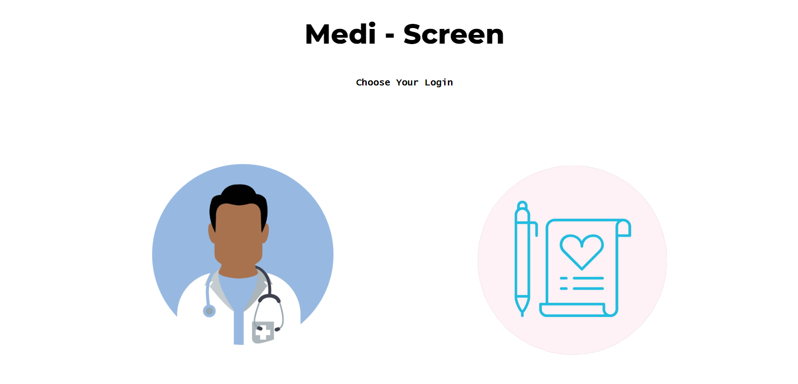
Web Portal Index (Front End)
This is the initial page upon loading the website, providing the option to select between either Doctor login or Insurer login
Both are images with a large border radius to make them round and both animate to zoom in on hover
On click takes you to the corresponding log in page

Slide 5
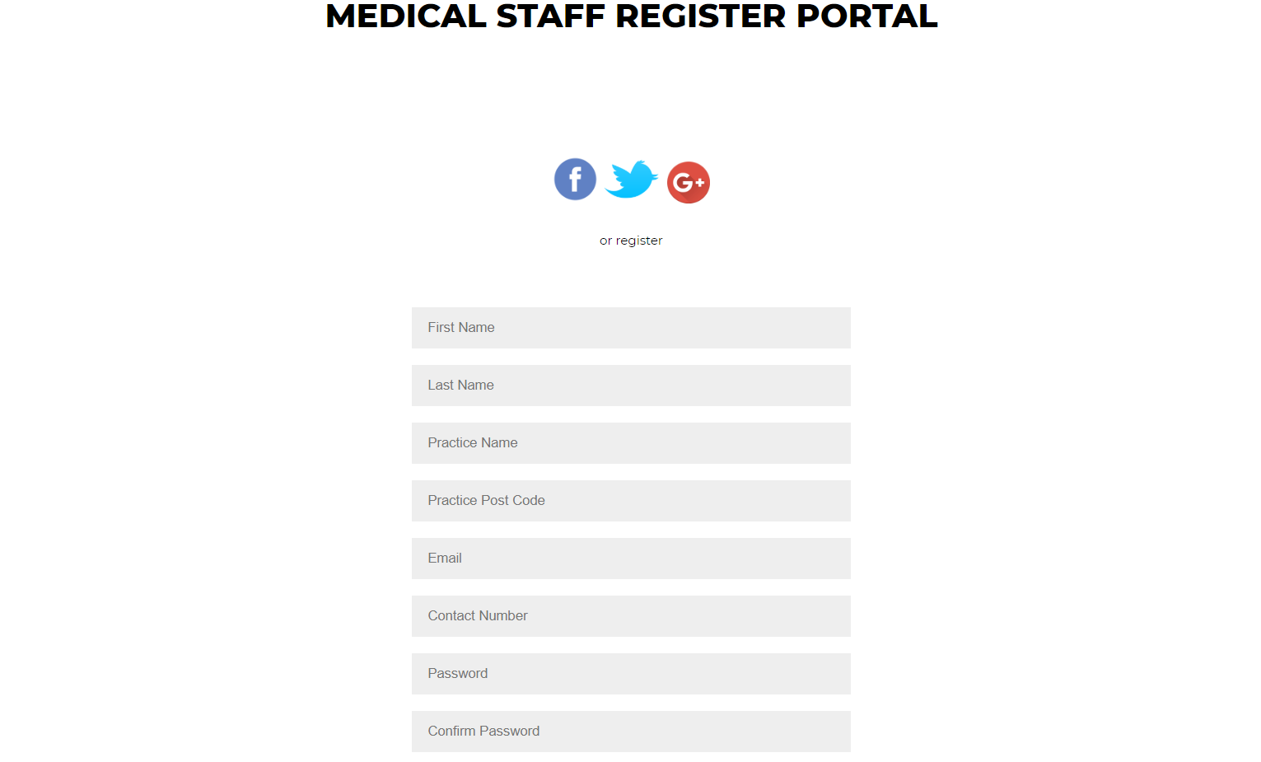
Doctor Signup (Front End)
All Fields are required for signup.
A simple script is used to compare password and confirm password. If they don’t match, a 1px solid red border is added to both boxes and signup is halted.
Once sign up is complete the user is directed to the home page and logged in

Slide 6
Doctor Signup (Back End)

Slide 7
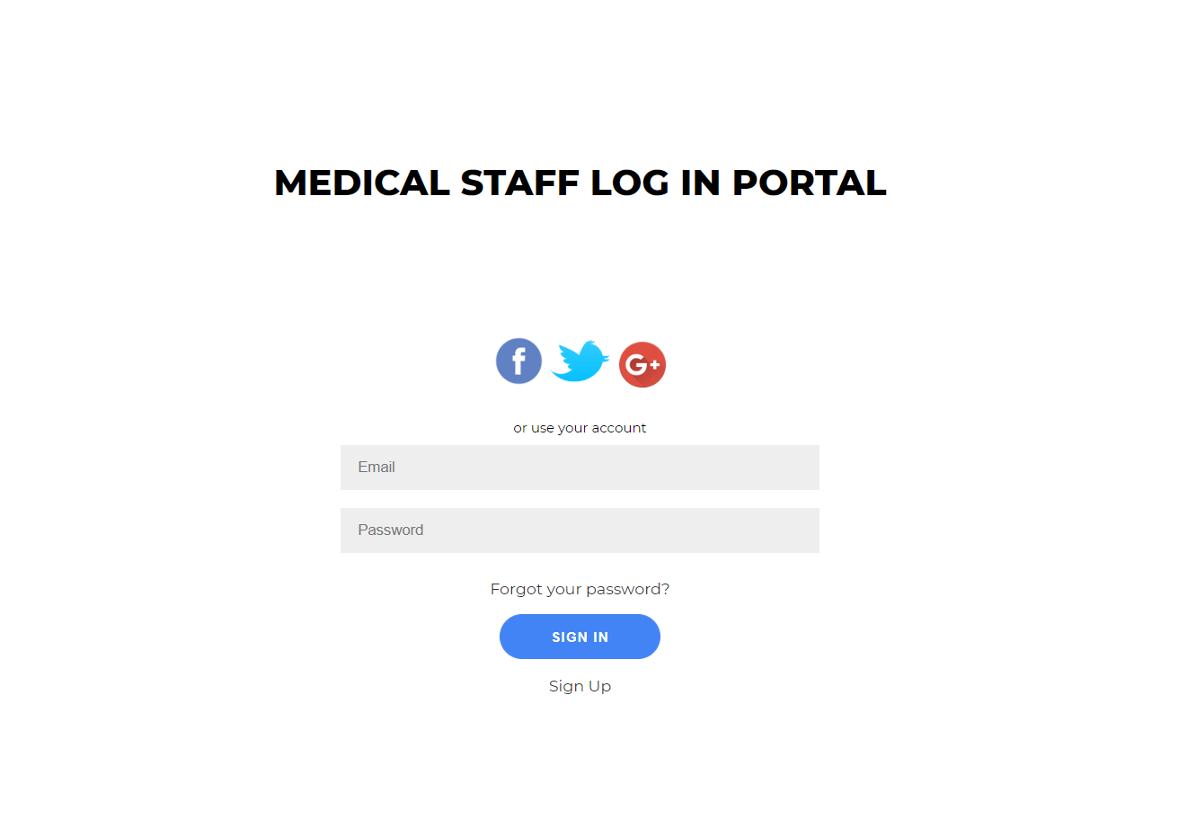
Doctor Login (Front End)
Email input requires ‘@’ to ensure an email is used.
If details are incorrect, the user is redirected to a page that tells them this account doesn’t exist and provides a link to the signup page.

Slide 8
Doctor Login (Back End)

Slide 9
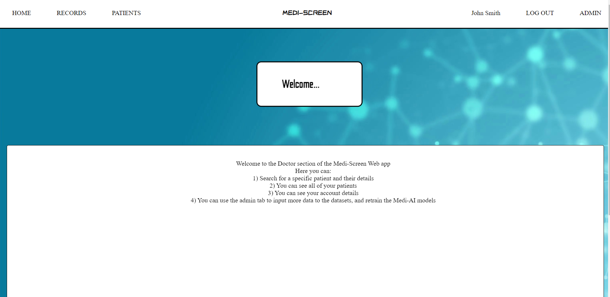
Doctor Home (Front End)
Menu at the top is fixed to the top and has a high z-index so it over laps anything when scrolling.
Home directs to this page. Records directs to searching by ID
Patients directs to the display for all your patients
Username leads to accounts page
Log Out sends the user to the index page to choose between medical and insurance logins
Admin leads to model training

Slide 10
Doctor Home (Back End)

Slide 11
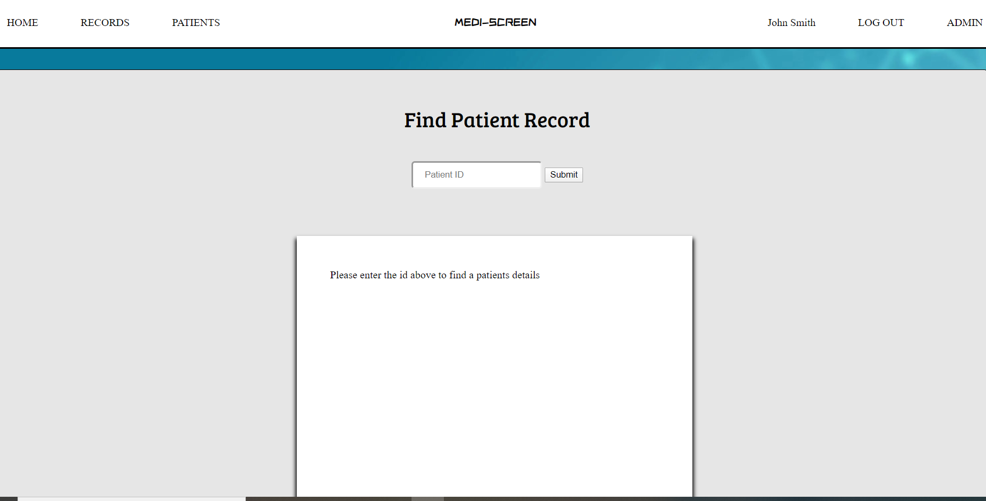
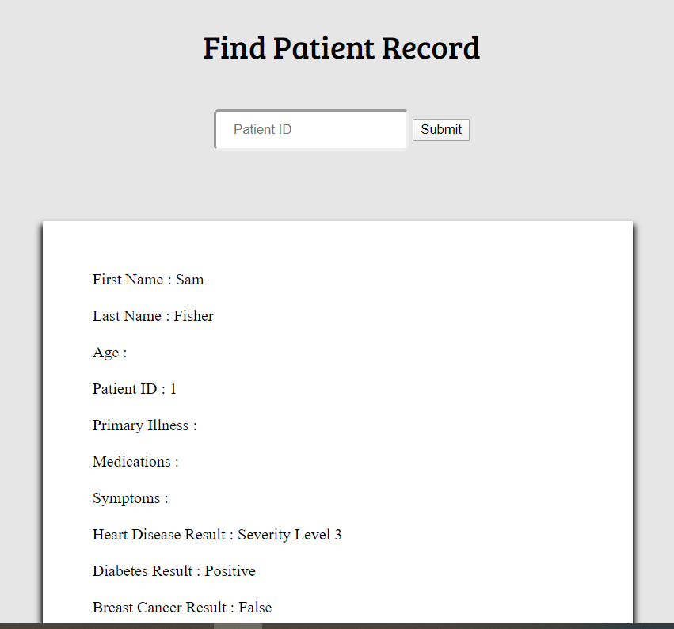
Doctor Records (Front End)
Here there’s a box to search by Patient ID.
If it exists, Fields will appear in the area below and contain the corresponding information to that Patient.
In the example displayed, the ID was simply ‘1’

Slide 12
Doctor Records (Back End)

Slide 13
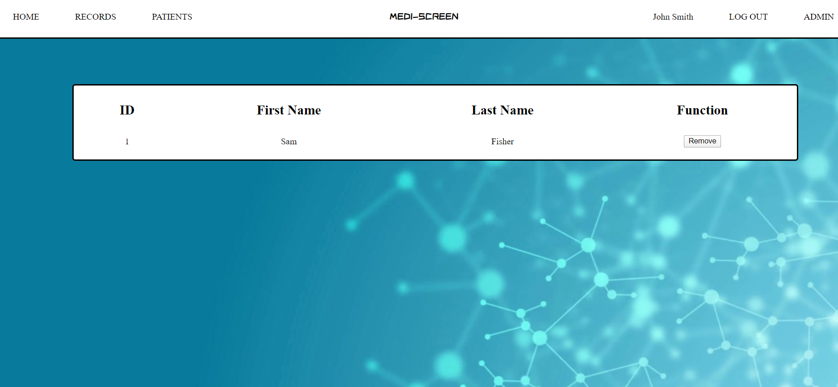
Doctor Patients (Front End)
Patients Page displays the ID and name of all the patients belonging to the logged in doctor
The remove button allows the doctor to remove that patient from their directory
The ID is provided so the doctor can search it in the Records Page

Slide 14
Doctor Patients (Back End)

Slide 15
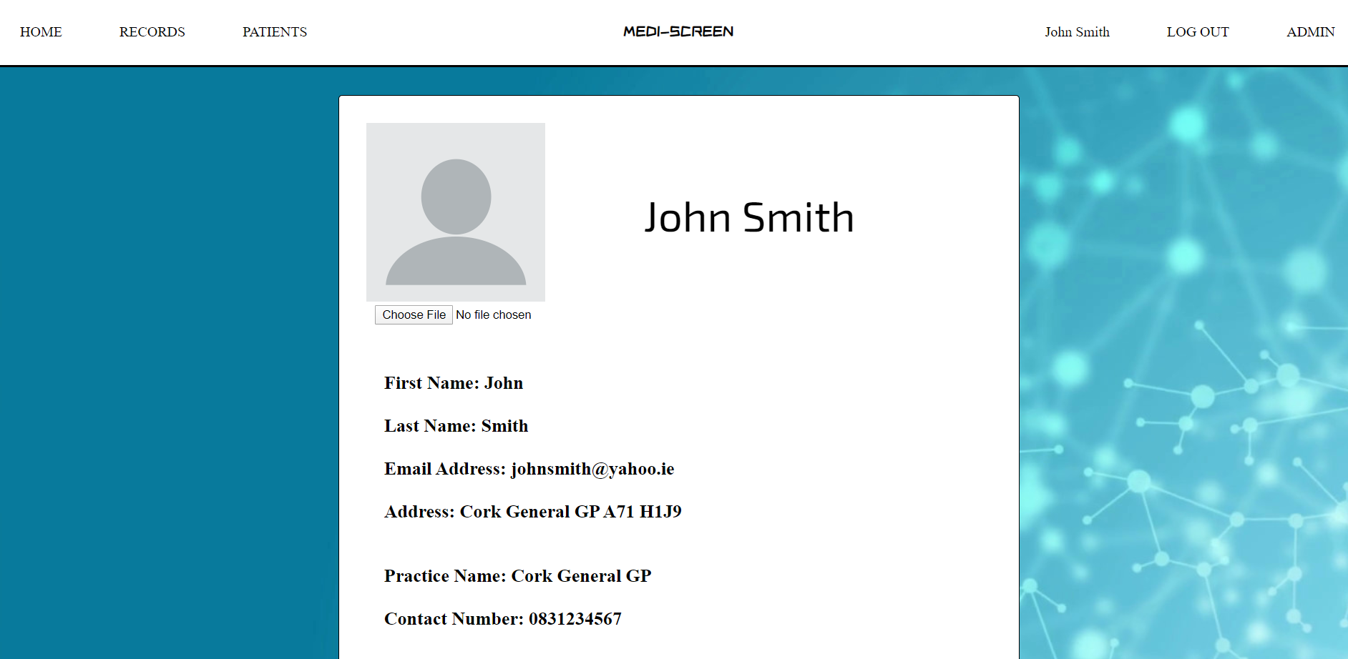
Doctor Account (Front End)
This page displays the relevant information about the logged in user such as name, email, address, practice and contact number

Slide 16
Doctor Account (Back End)

Slide 17
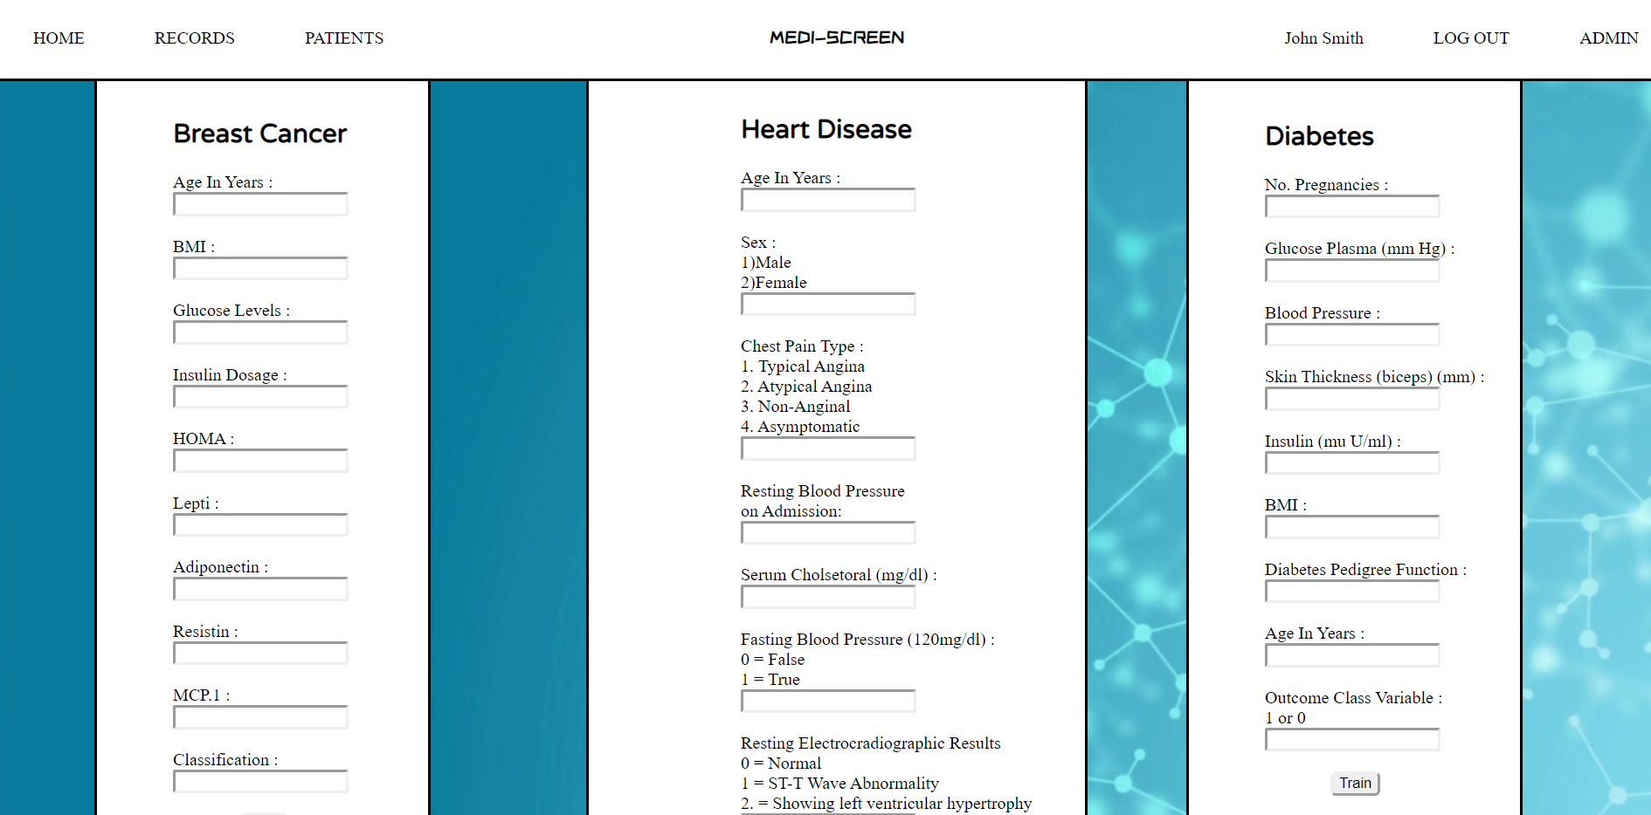
Doctor Admin (Front End)
The Admin Page displays forms for each dataset that is used for the patients to determine the chance of Breast Cancer, Diabetes and Heart Disease
Each Form has different entries and a button at the end submits the entries for that dataset

Slide 18
Doctor Admin (Back End)

Slide 19
Insurance Web Portal

Slide 20
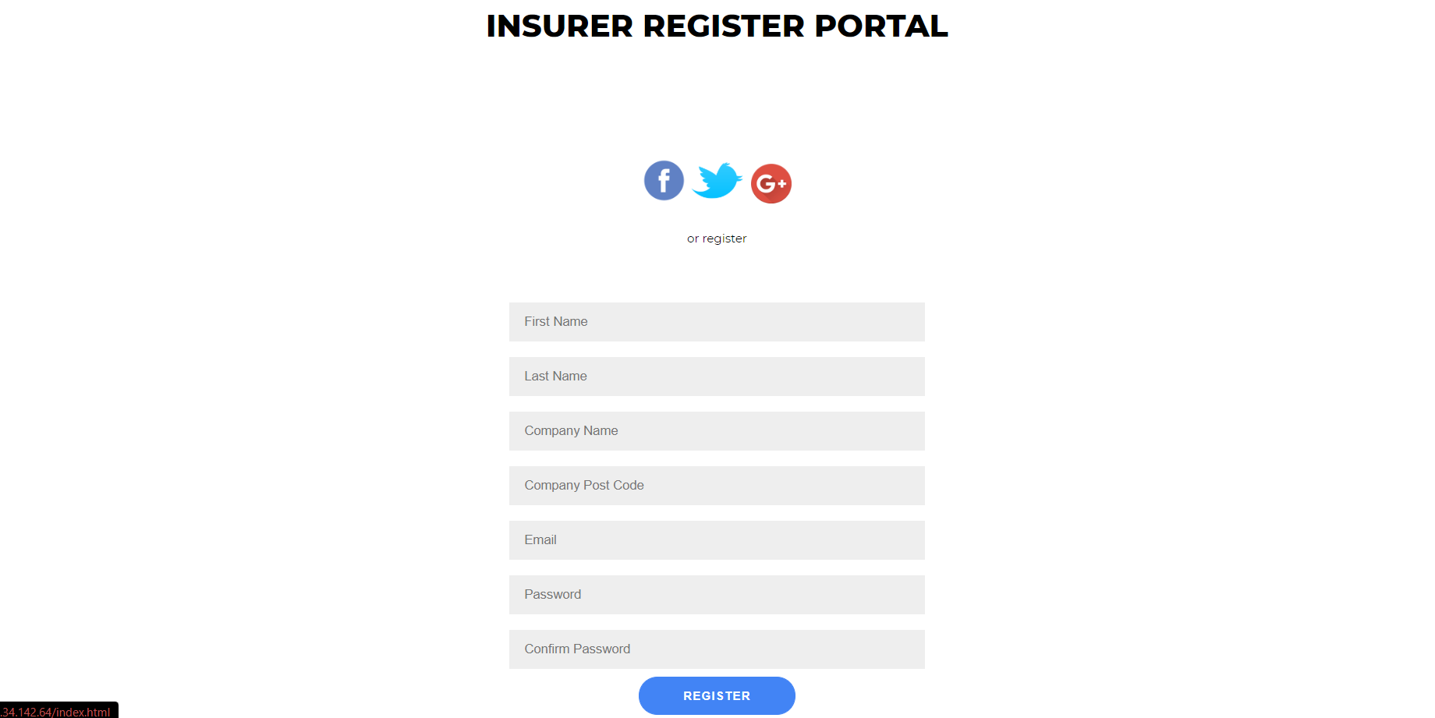
Insurer Sign Up (Front End)
All Fields are required to successfully SignUp as an insurer
The same script as doctor signup is used for password comparison to ensure they match
Once Signed up the user is redirected to the home page and logged in.

Slide 21
Insurer Sign Up (Back End)

Slide 22
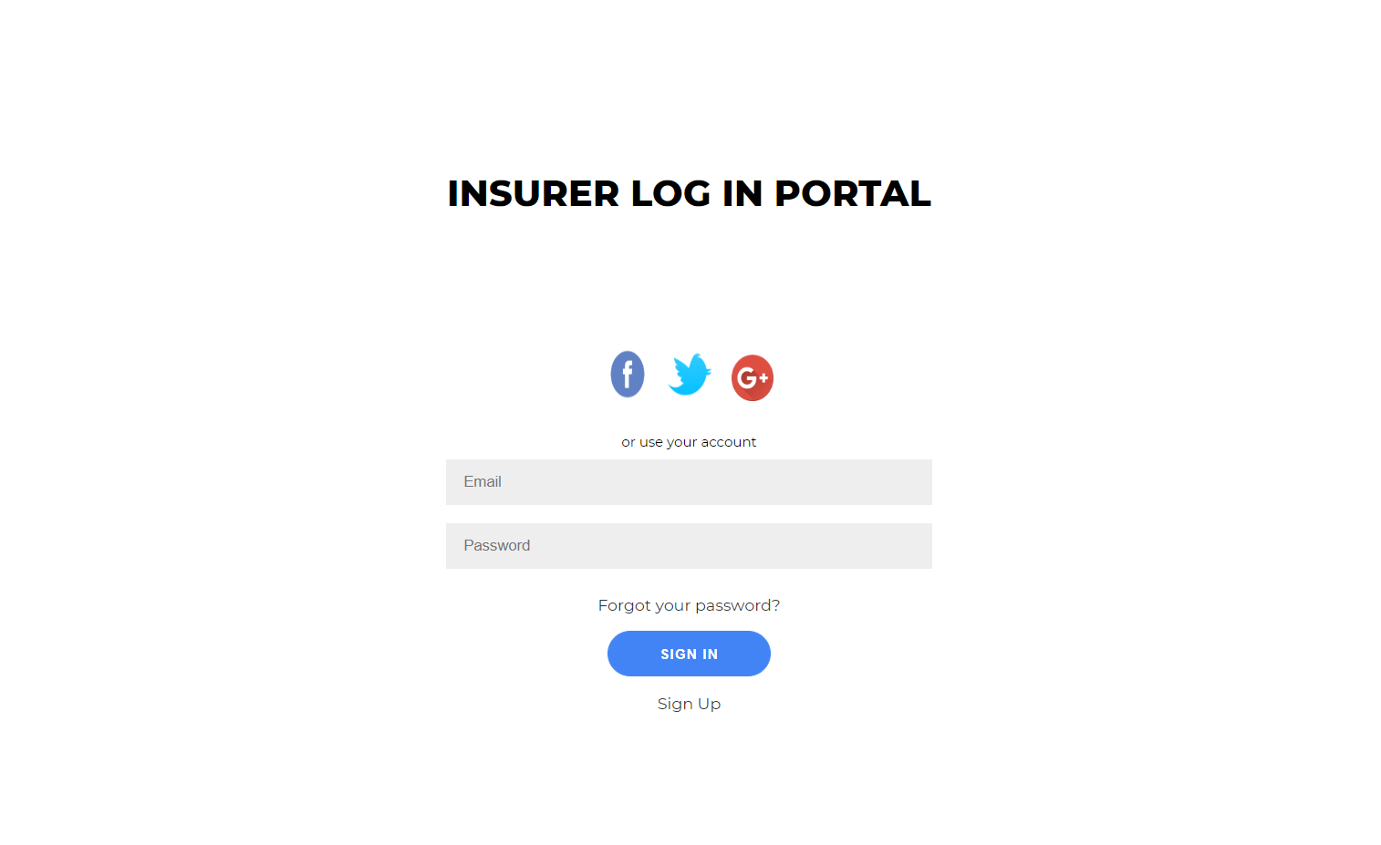
Insurer Log In (Front End)
‘@’ is required in the email field to make sure an email is entered.
If the account already exists then the user is redirected to a page telling them it exists and a link to sign up is provided.

Slide 23
Insurer Log In (Back End)

Slide 24
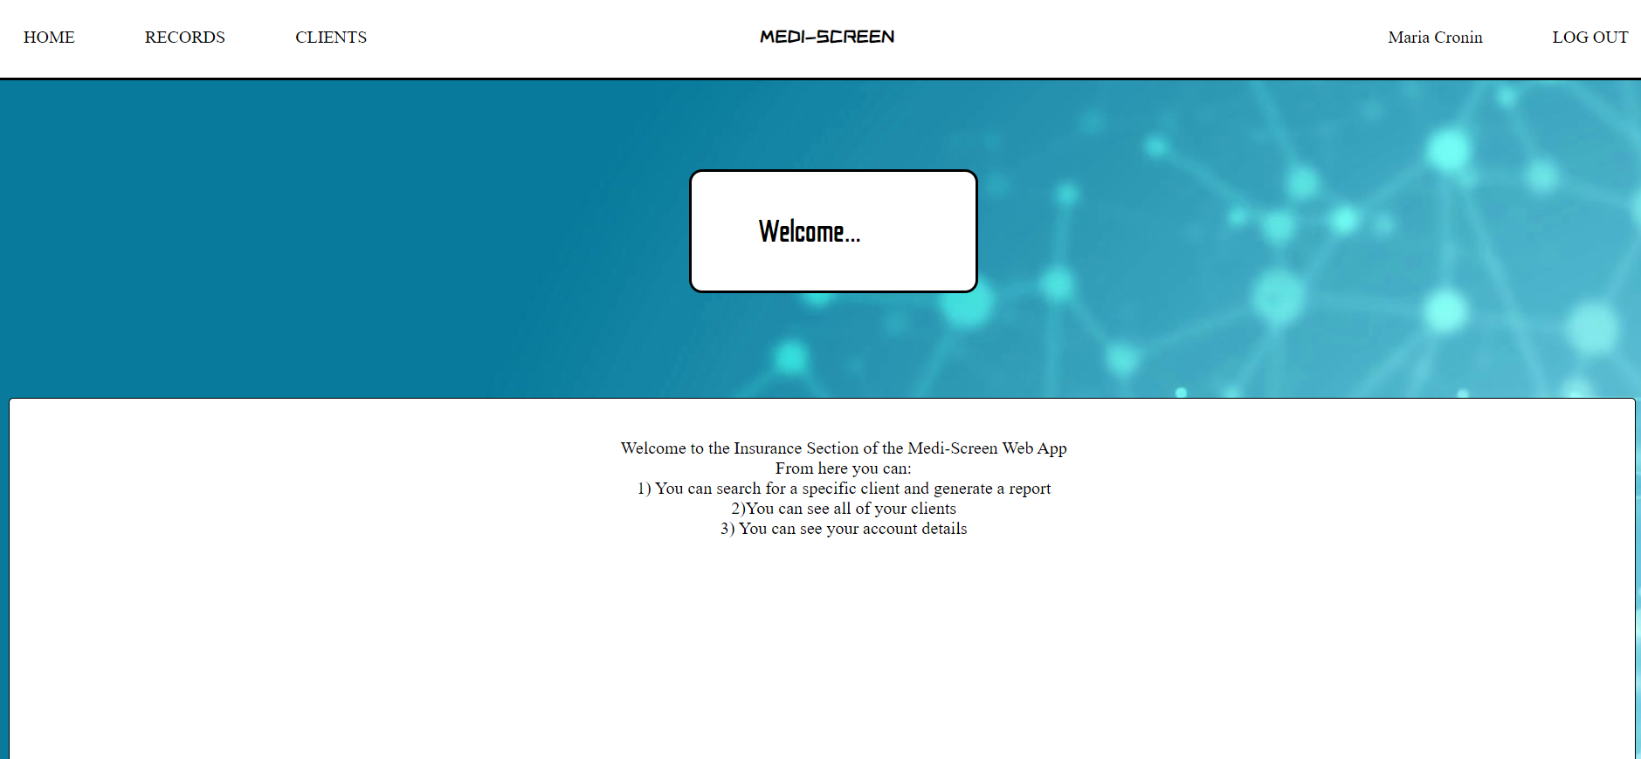
Insurer Home (Front End)
Home links to this page
Records allows logged in users to search for their insured clients by ID
Clients displays all the insurers clients (limited to the logged in user)
Username links to an account page
Log out redirects the user to the index page to choose between doctor and insurer login

Slide 25
Insurer Home (Back End)

Slide 26
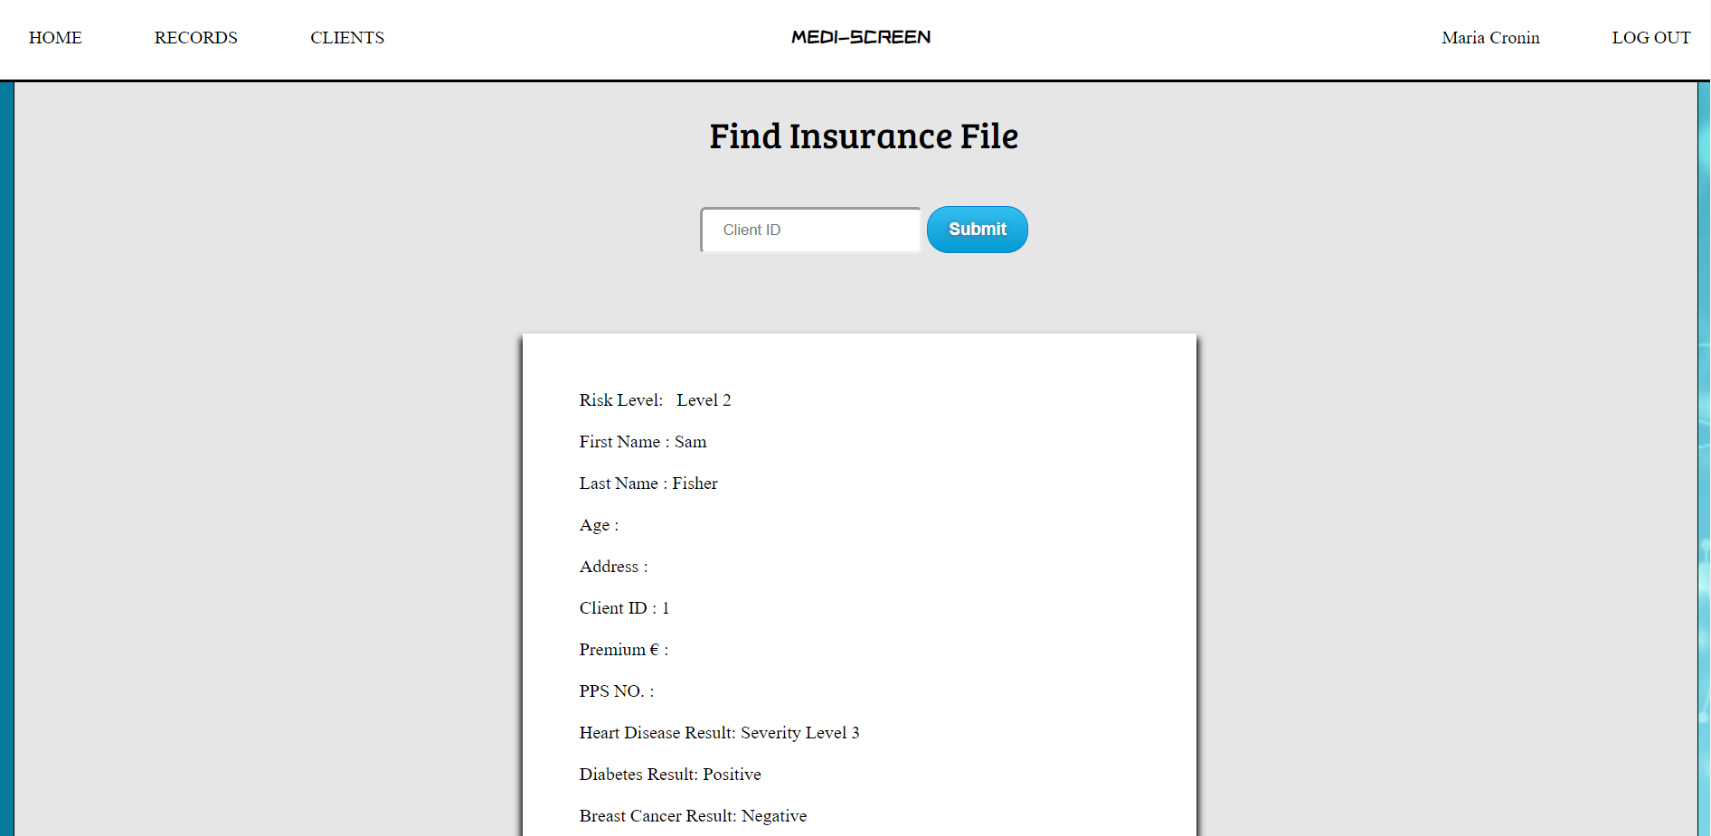
Insurer Records (Front End)
This page displays clients risks and illnesses along with other information based on Client ID
In this image, the ID used was ‘1’
Clients that can be displayed are limited to the insurer that’s logged in. No other insurers records can be viewed

Slide 27
Insurer Records (Back End)

Slide 28
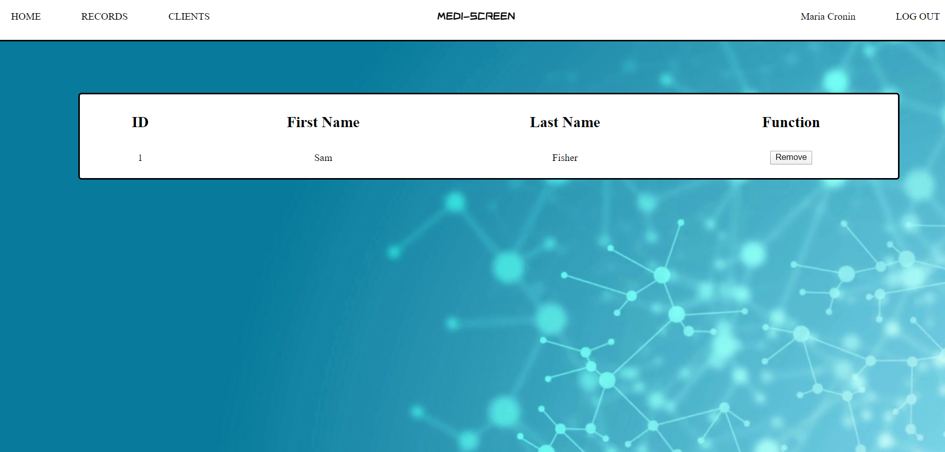
Insurer Clients (Front End)
Clients displays all the clients insured by the logged in insurer.
The remove button directly removes the client from the insurers list of clients
The ID can be searched in Records for a detailed report about the clients illnesses and risk

Slide 29
Insurer Clients (Back End)

Slide 30
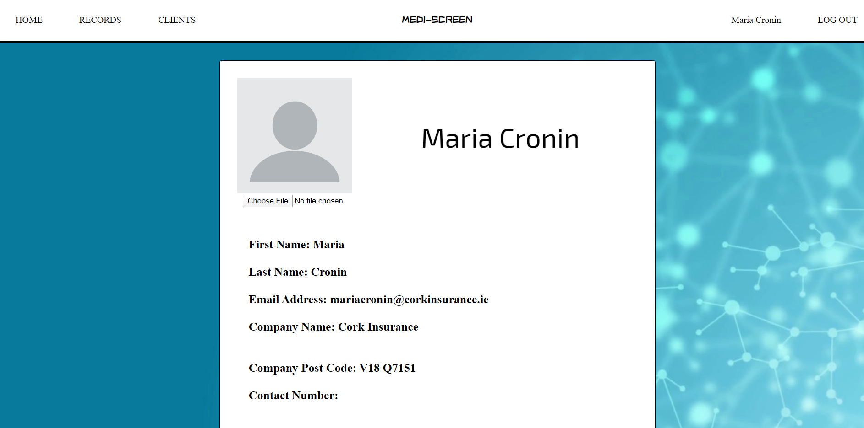
Insurer Account (Front End)
The Account displays the logged in insurers name, email, Insuring Company, Company post code and contact number

Slide 31
Insurer Account (Back End)

